Slide 1
The Robotics Master of Science Program
George Kantor
Chair, MS Robotics Program

Slide 2
RI Graduate Programs
Doctor of Philosophy (PhD) The world's first doctoral program in robotics prepares graduate students to be tomorrow's leaders in robotics research.
Master of Science (MSR) A two year master’s program that teaches the fundamentals of robotics theory and practice through coursework and independent research. (YOU!)
Master of Science - Robotic Systems Development (MRSD) A four-semester advanced graduate degree with a combined technical/business focus for recent- graduates/practicing-professionals engaged in, or wishing to enter, the robotics and automation field as practitioners in the commercial sector.
Master of Science – Computer Vision (MSCV) A 16 month master’s program that teaches the fundamentals of computer vision theory to prepare students for careers in industry.

Slide 3
MSR Requirements / Curriculum
Core Courses
4 Courses (48 units) One in each category: Perception, Cognition, Action and Math.
Research Units
Thesis
Public thesis talk
Elective Courses
3 Courses (36 units) At graduate level
84 units of 16-997 (Reading & Research)
Master’s thesis document
Notes:
Note 48 + 36 + 84 = 168
4 x 36 (for 4 semesters) + 24 (1 summer) = 168
Funded students must register for 24 units of research

Slide 4
Core Courses
Perception
16-720 Computer Vision (Fall and Spring)
16-722 Sensing and Sensors (Spring)
Cognition
15-780 Graduate Artificial Intelligence (Spring)
10-601 Machine Learning (MS Level – Fall and Spring)
10-701 Machine Learning (PhD Level – Fall and Spring)
Action
16-711 Kinematics, Dynamic Systems, and Control (Spring)
16-741 Mechanics of Manipulation (Fall)
Math Foundations
16-811 Math Fundamentals for Robotics (Fall)
Notes:
Colored courses are offered in fall (note the difference in difficulty between 16-720 A and B)

Slide 5
Elective Courses
3 courses – minimum of 36 units.
Should be approved by MS Program Chair *before* you take it.
All Robotics Institute graduate level courses are pre-approved (16-600 and above)
All other electives must be approved by sending email to George (and CC’ing BJ)
Guidelines for approval:
- must be a graduate level class
- must be related to your research topic

Slide 6
Research and Thesis
Purpose: Learn how to conduct first-rate research.
First Year
Match with an RI research advisor - by October 31st
Form your thesis committee - by the end of your first year Thesis Committee consists of your research advisor(s), additional faculty member and an advanced RI PhD Student (student who has completed their 2nd year or graduated from the MSR program)
Work with research advisor to determine direction of thesis.
*Thesis may not be (or identical to) a conference or journal submission.

Slide 7
MSR Research and thesis
Second Year
Work with research advisor(s) and meet regularly with committee members
Provide written thesis draft to committee members at least two weeks before your thesis talk
Give good (1hr) thesis talk (advertise and answer questions) (PhD speaking qualifier)
Make thesis corrections and upload as an RI Technical Report / MS Thesis

Slide 8
Finding a Research Advisor
Your most important decision!
Considerations
Research Area
Reputation/ Connections
Things To Do
Attend Orientation talks
Talk to faculty!
Management Style
Scientific Style
PERSONALITY!
Lab Environment (where?)
Go to RoboOrg events
Talk to students
Read papers & websites
Attend lab meetings
Funding Sources

Slide 9
MS Advisor Selection Process
Come to mutual agreement by October 31st
Must have connection with RI – (not emeritus status) https://www.ri.cmu.edu/people/faculty/
Email George (CC: BJ) and the faculty member to confirm the match.
NOTE: A faculty advisor *does not* pick up your tuition tab; they provide advice
Issues: Talk to George

Slide 10
On Campus Research
Some professors currently have on campus research activities, some are in the process of re-starting on-campus activities
“What can be done remotely must be done remotely”
In order to be on campus for any research activity, you must be listed on someone’s “return to research” plan
Talk to potential advisors explicitly about this!
Are they planning to return
Do they expect your research to have an on-campus component
Will they add you to their return to research plan
If so, which areas, what times

Slide 11
Financial Support
MSR is a self-funded program.
You are not eligible for support until the spring semester (hourly or stipend). (Unless it is outlined in your offer letter before you accepted in March.)
Your advisor may have the means to provide some research assistantship (RA) support in the form of tuition or stipend. (full or partial)
RA positions are on a semester by semester basis and never guaranteed.
Bottom line: you should be financially prepared to cover your full-time tuition and living expenses through graduation

Slide 12
Advisor Communication
Communicate openly and honestly with your (potential) advisor
Be clear about your expectations and goals
Do you require funding?
Do you plan to take an internship?
Do you want to publish?
Do you plan to take time off around the holidays?
Etc.

Slide 13
Accelerated Students (NOT 5th year Masters!)
Accelerated MS Students are
Graduates from CMU undergrad program (CS, ECE, MechE)
Have made some progress toward fulfilling MSR requirements
Got in through a slightly different admissions process
Those things are all in the past! Now that you are in the program, there is no distinction between Accelerated and “normal” MSR students
You should be able to finish in under two years but
Pay attention to your requirements!
Talk to you advisor early and often about schedule!

Slide 14
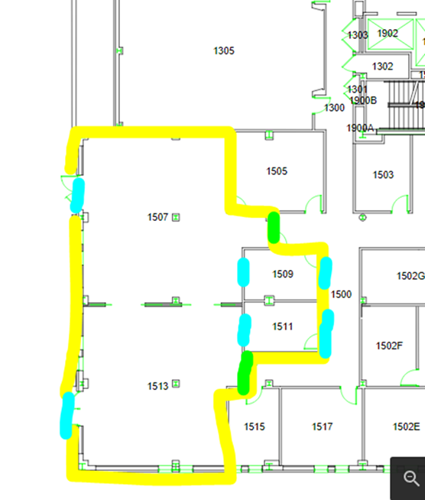
RI Graduate Student Space
NSH 4228
Day space for quieter work; Tables and chairs for about independent work; No items to be stored here
Grad Student Conference Rooms
NSH 4228A / 4228B, 4222 and 4224: Project/team rooms available for student booking; Seats 6-8 each (Use Online Scheduler to schedule these rooms.)
RoboLounge
NSH 1505 (ID card access)
Newly renovated!!
Notes:
Use reasonable person principle

Slide 15
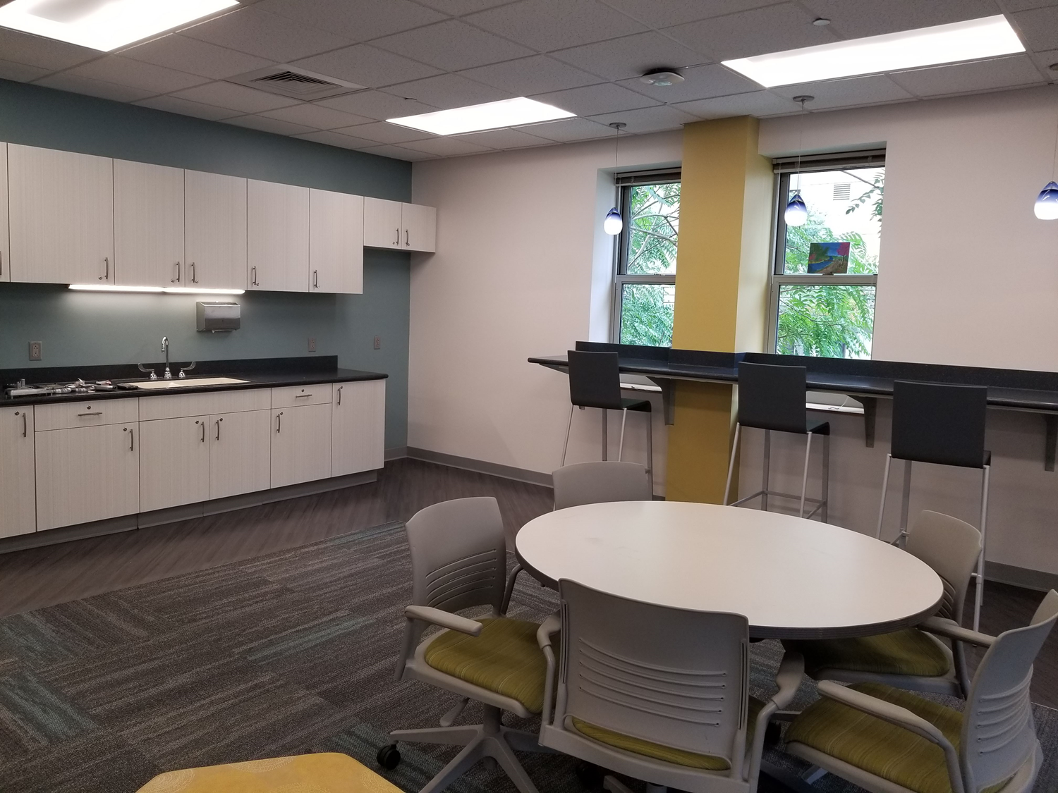
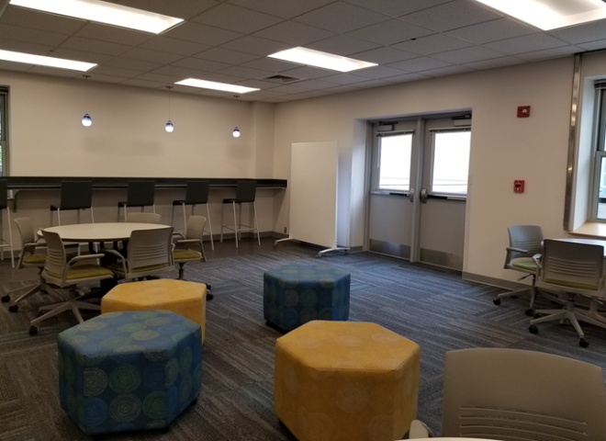
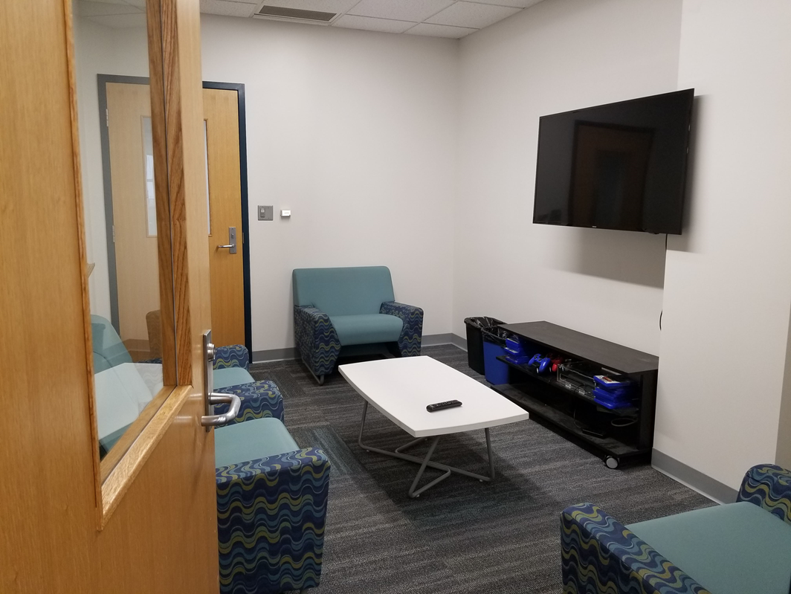
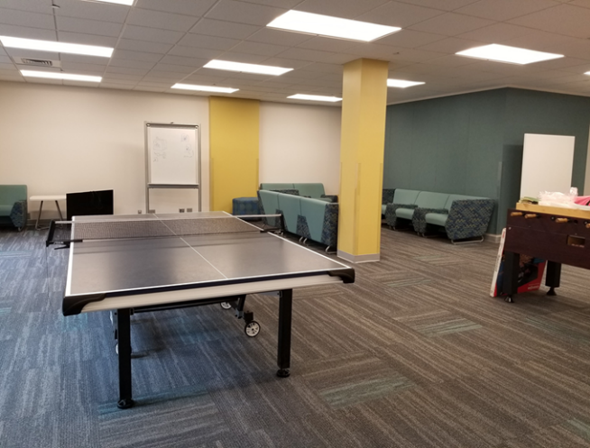
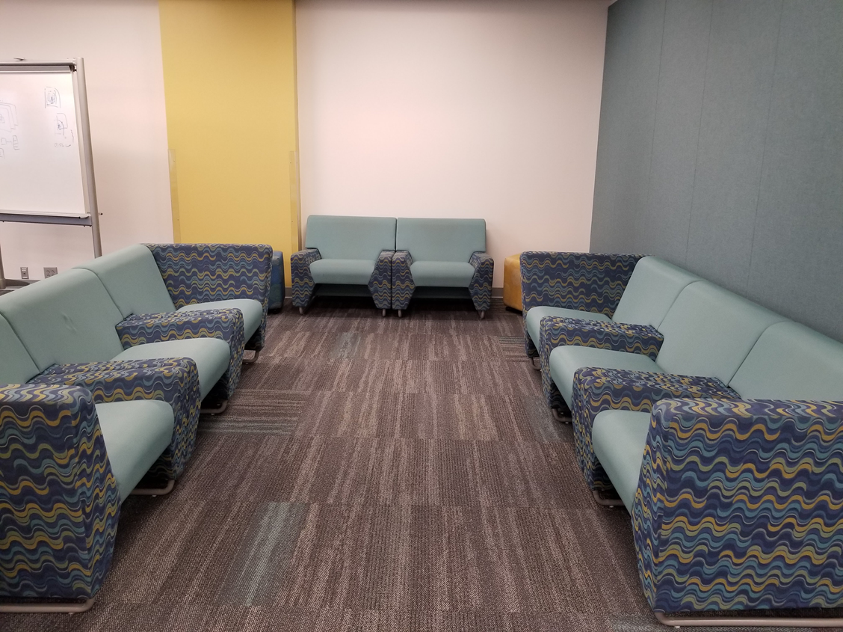
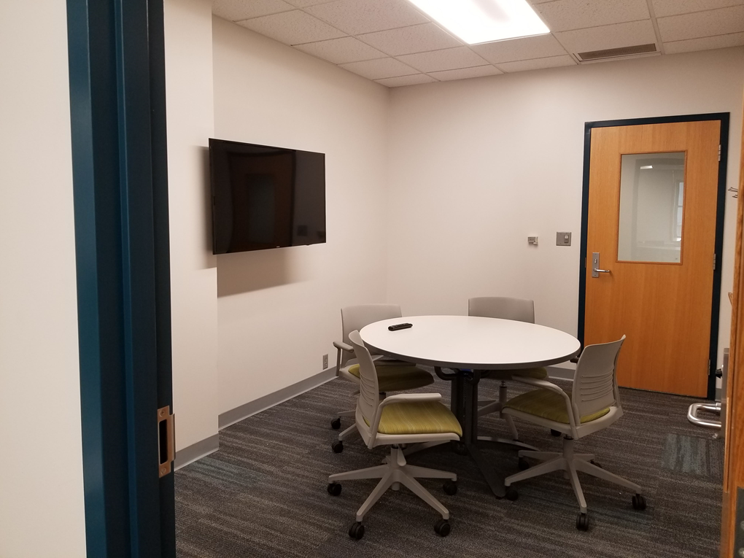
New-ish RI RoboLounge
Notes:
Use reasonable person principle

Slide 16
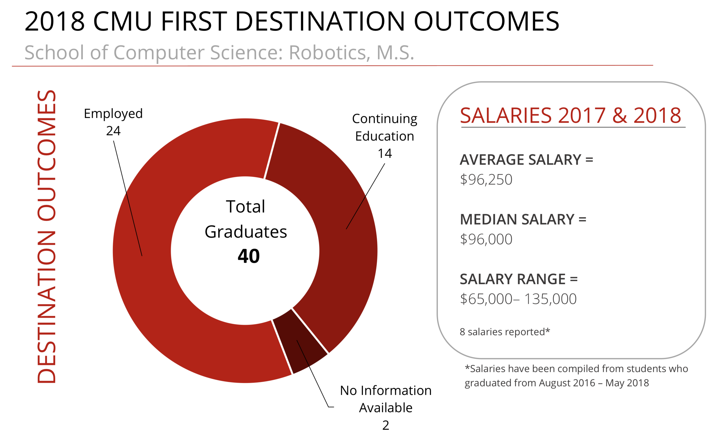
Post Program Statistics
Career and Professional Development Center gathers First Destination data: https://www.cmu.edu/career/about-us/salaries-and-destinations/post-grad-dashboard.html
Notes:
Please fill out surveys from Career and Professional Development Center, especially Julie Goldstein and Kevin Collins

Slide 17
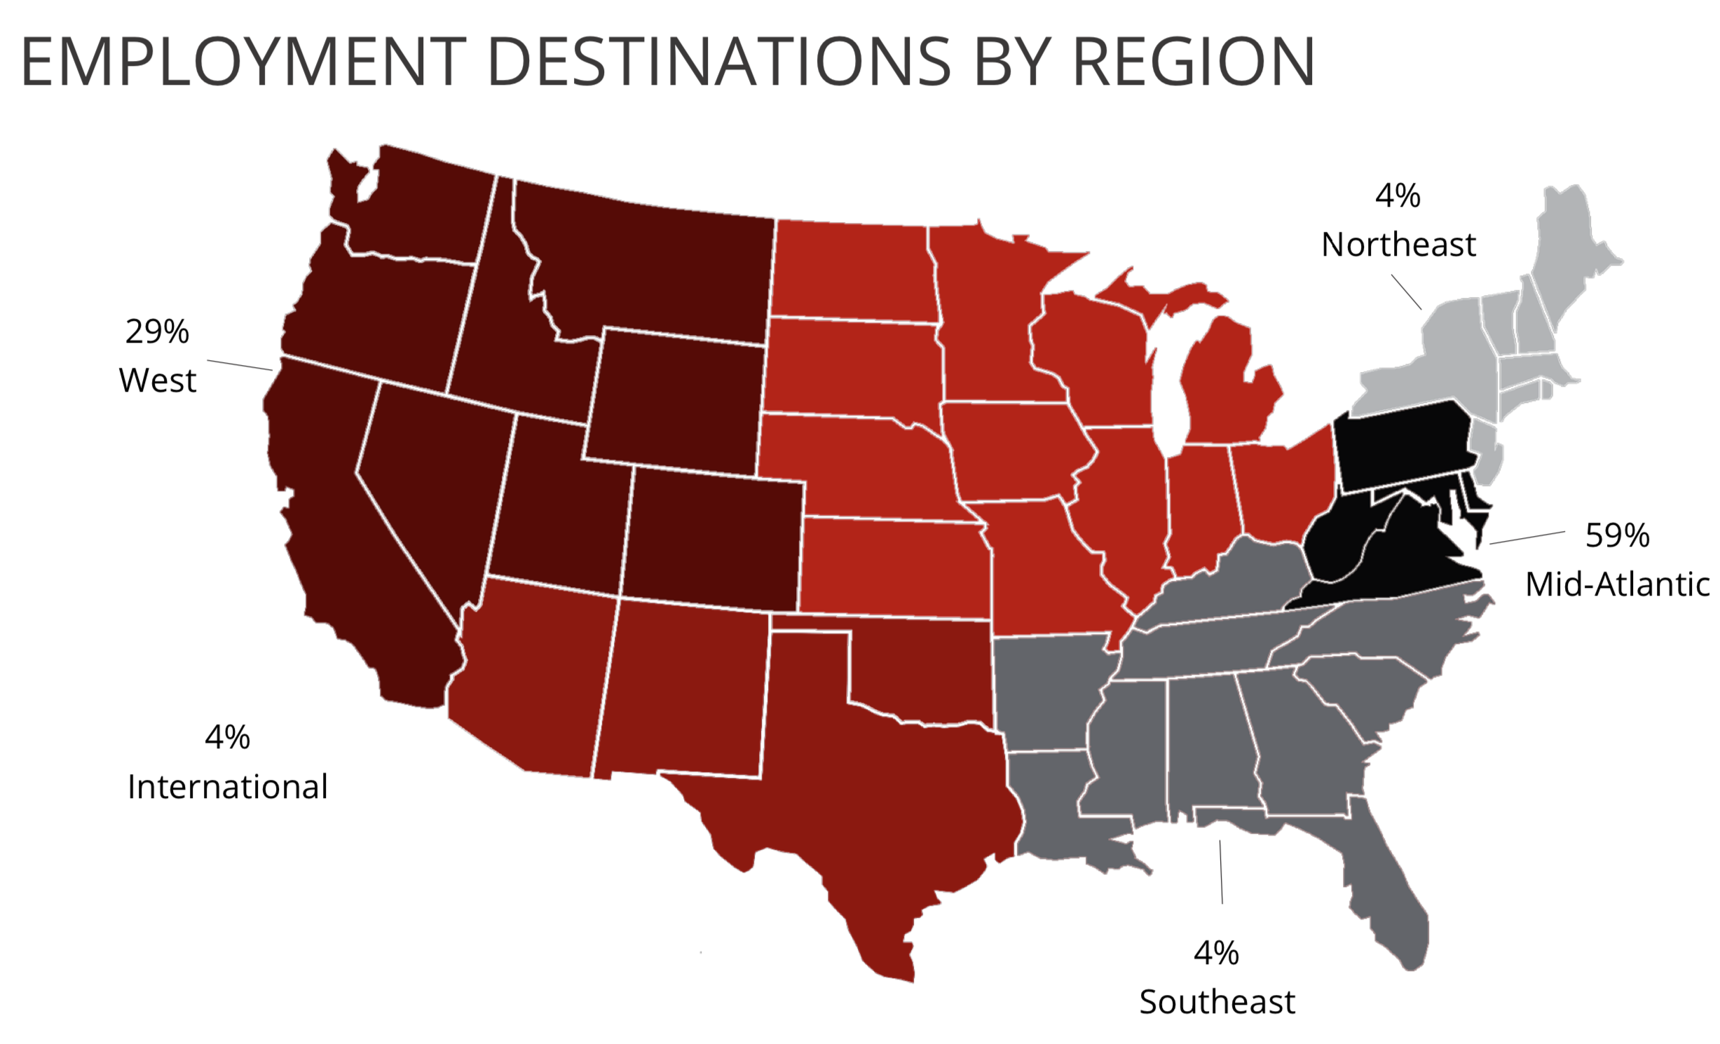
Post Program Statistics
PhD Programs CMU Robotics/HCII (9), Stanford, ETH Zurich
Employment Destinations
Aurora, CMU/NREC, Exadler, Fetch, Honeybee, Illuvator CoreX, MechaSpin, Microsoft, Nimbus, Optimus Ride, Plenty, Shield AI, Uber, UPMC
Career and Professional Development Center gathers First Destination data: https://www.cmu.edu/career/about-us/salaries-and-destinations/post-grad-dashboard.html
Notes:
Please fill out surveys from Career and Professional Development Center, especially Julie Goldstein and Kevin Collins

Slide 18
Follow Up Q&A
We’ll have an open Q&A session later this week: When:
Choices:
Thursday 8-9am
Thursday 11am-noon
Friday 8-9am

Slide 19
Orientation Survey Topics (past years)
Ways of getting involved in research at the labs in the RI
Process of matching / finding a research advisor
Funding opportunities for F18, probability of funding for future semesters
Co-Advisors
Conversion to PhD program
Summer internships – where do MSR students go? Other university research groups or research companies / research labs?
Including advisors from outside of RI? How we can work with multiple professors from different departments/areas. Any ongoing collaborations?
Completing the degree early and spend the rest of the time as an intern?
MSR thesis – all possible things that can be covered (topic selection, writing, defending, etc)

Slide 20
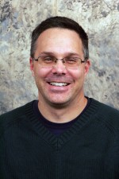
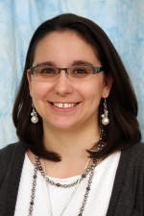
Additional questions?
Program Director George Kantor Senior Systems Scientist, RI kantor@cmu.edu
Approves any exceptions, electives, independent studies
Assists with research advisor and any robotics content question
Signs (or provides permission for B.J. to sign) anything for your “Advisor”
Implements changes / exceptions
Collector of / assists with signatures
Here to help with anything non – technical
Can always be your first stop (for anything except immigration, or taxes…)
Cc her on all correspondence with George!
Program Manager Barbara Jean (B.J.) Fecich Academic Program Manager, RI barbarajean@cmu.edu

